Slide 1
Dr. Laurend SLAIMAN

Slide 2
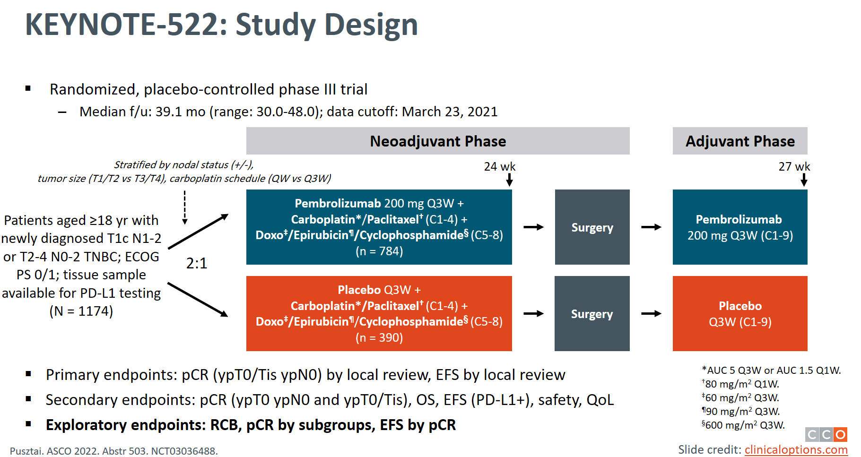

Slide 3
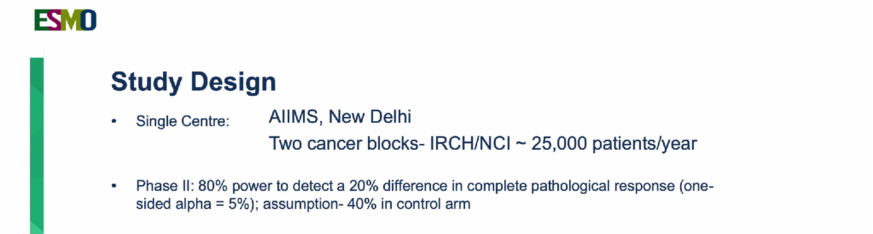


Slide 4
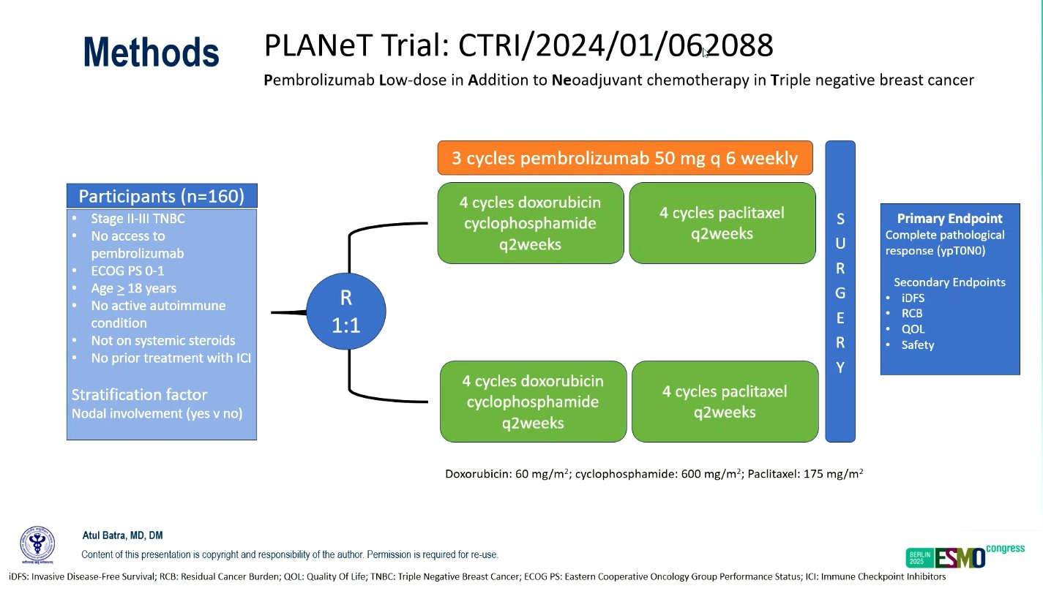

Slide 5
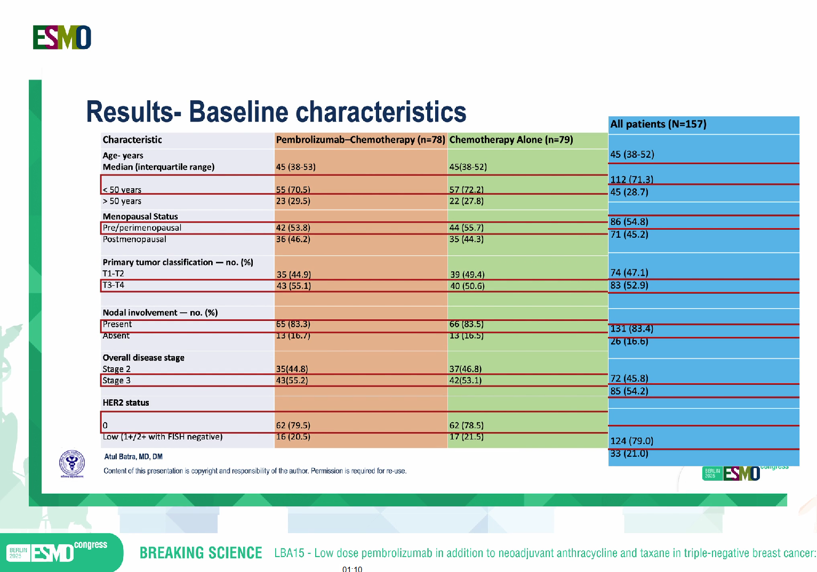

Slide 6
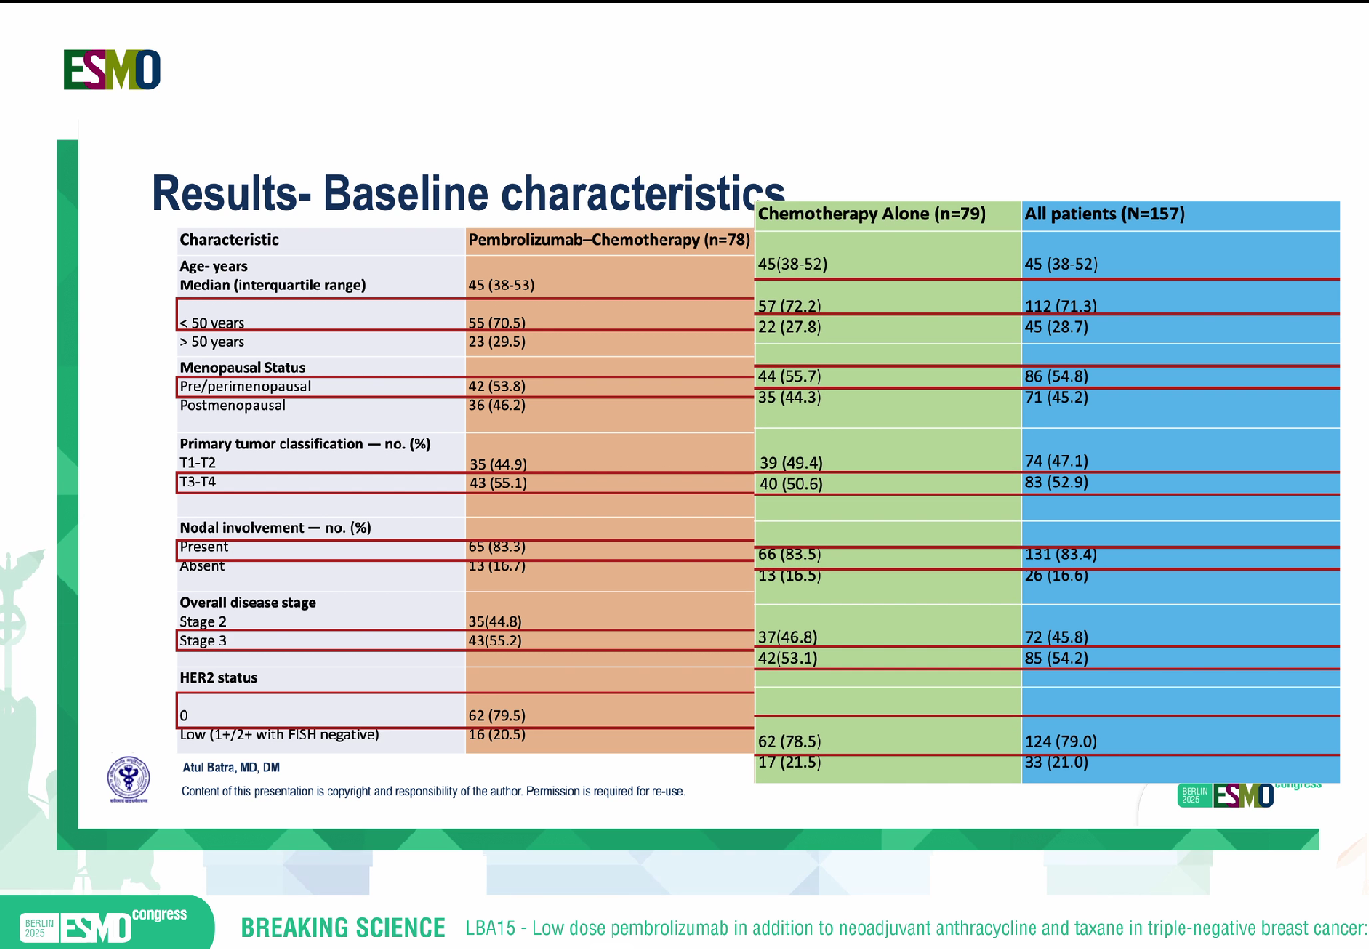

Slide 7
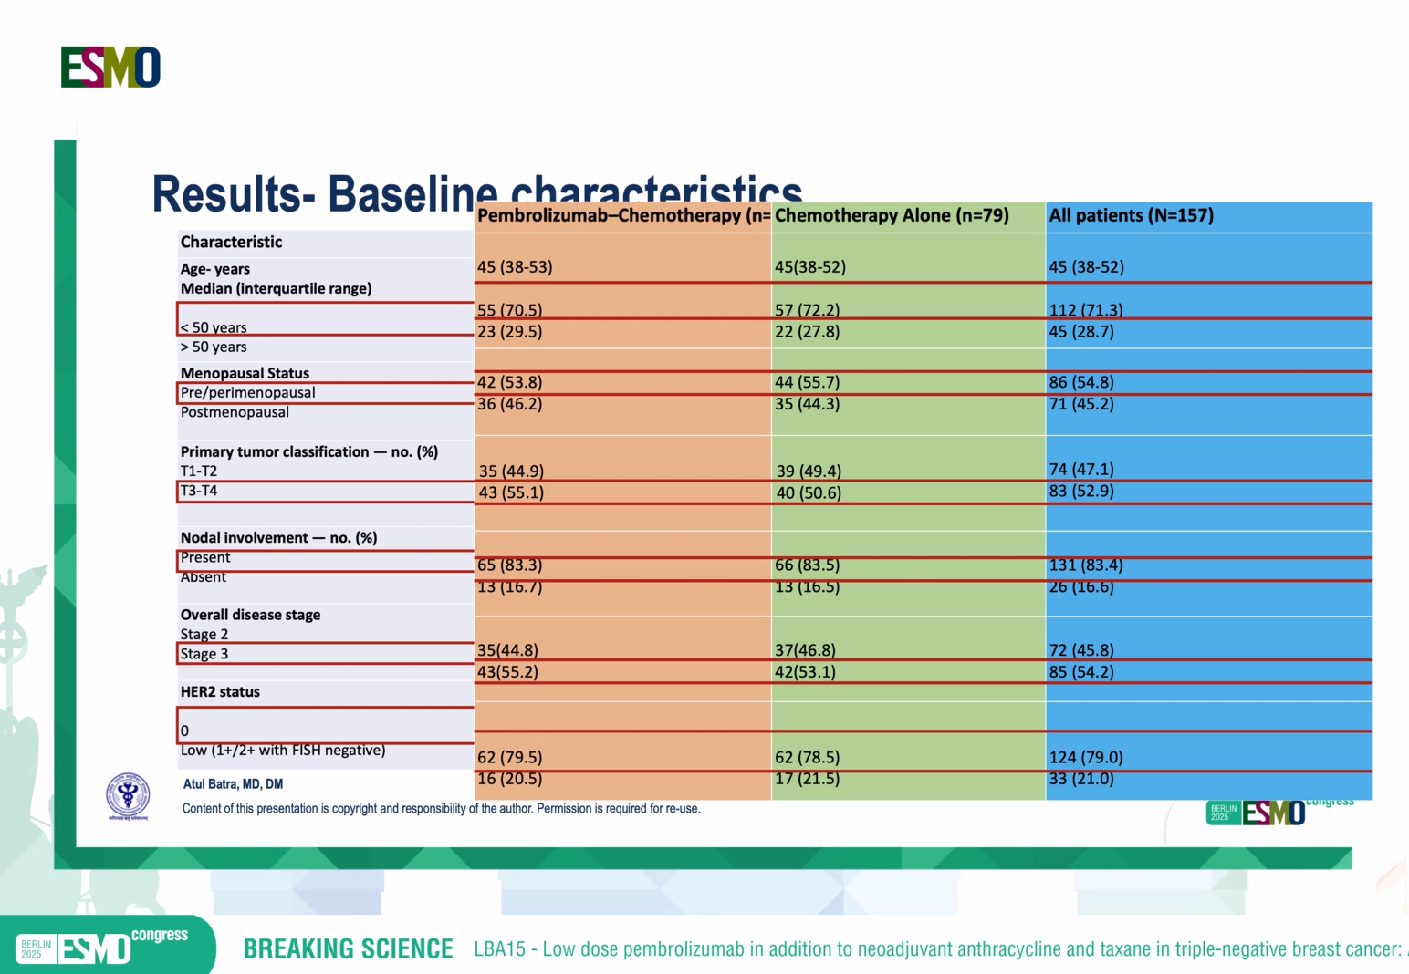

Slide 8
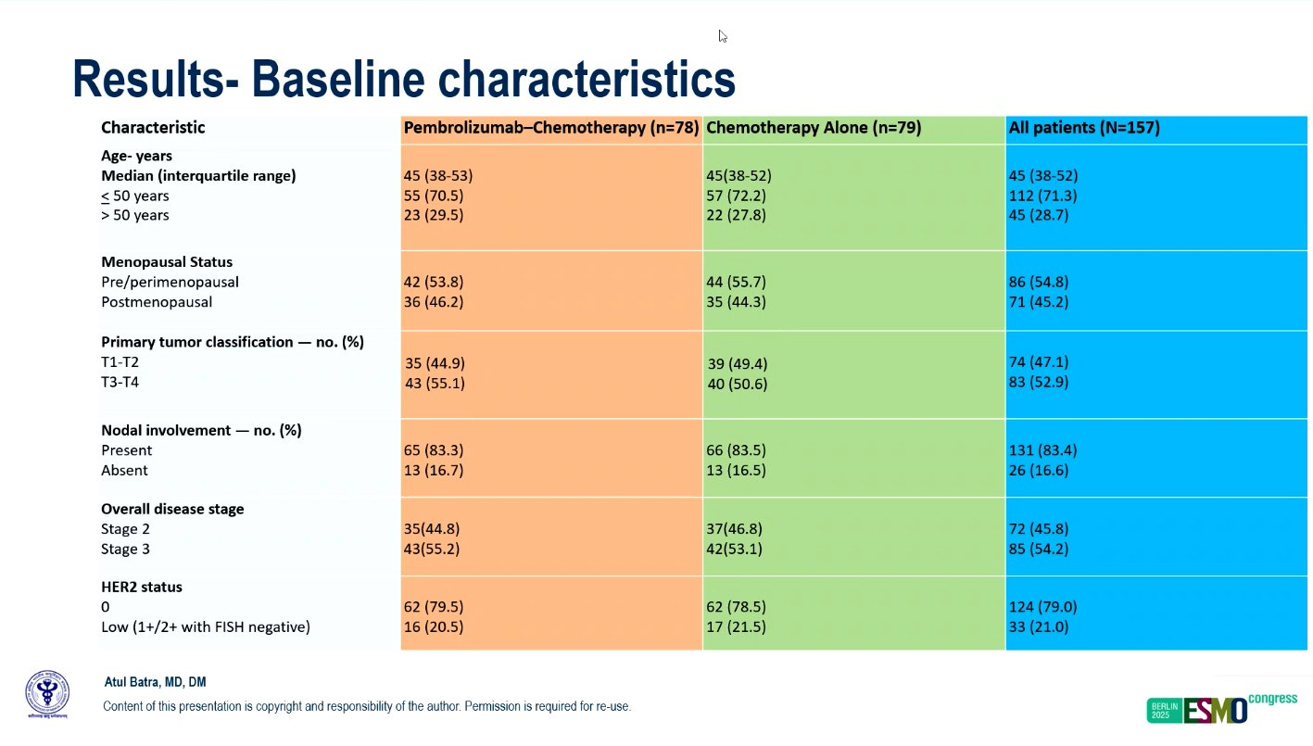

Slide 9
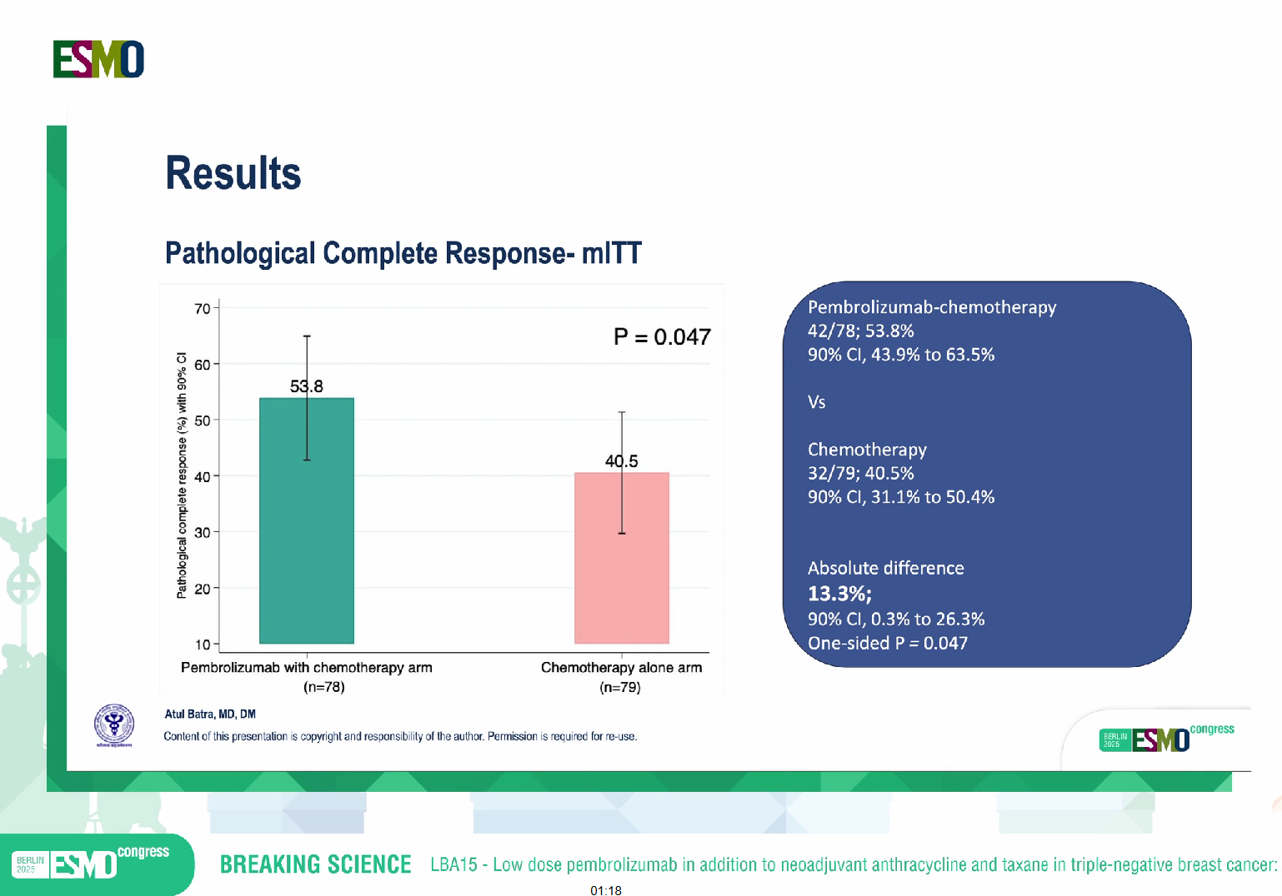
Absolute difference
13.3 %

Slide 10
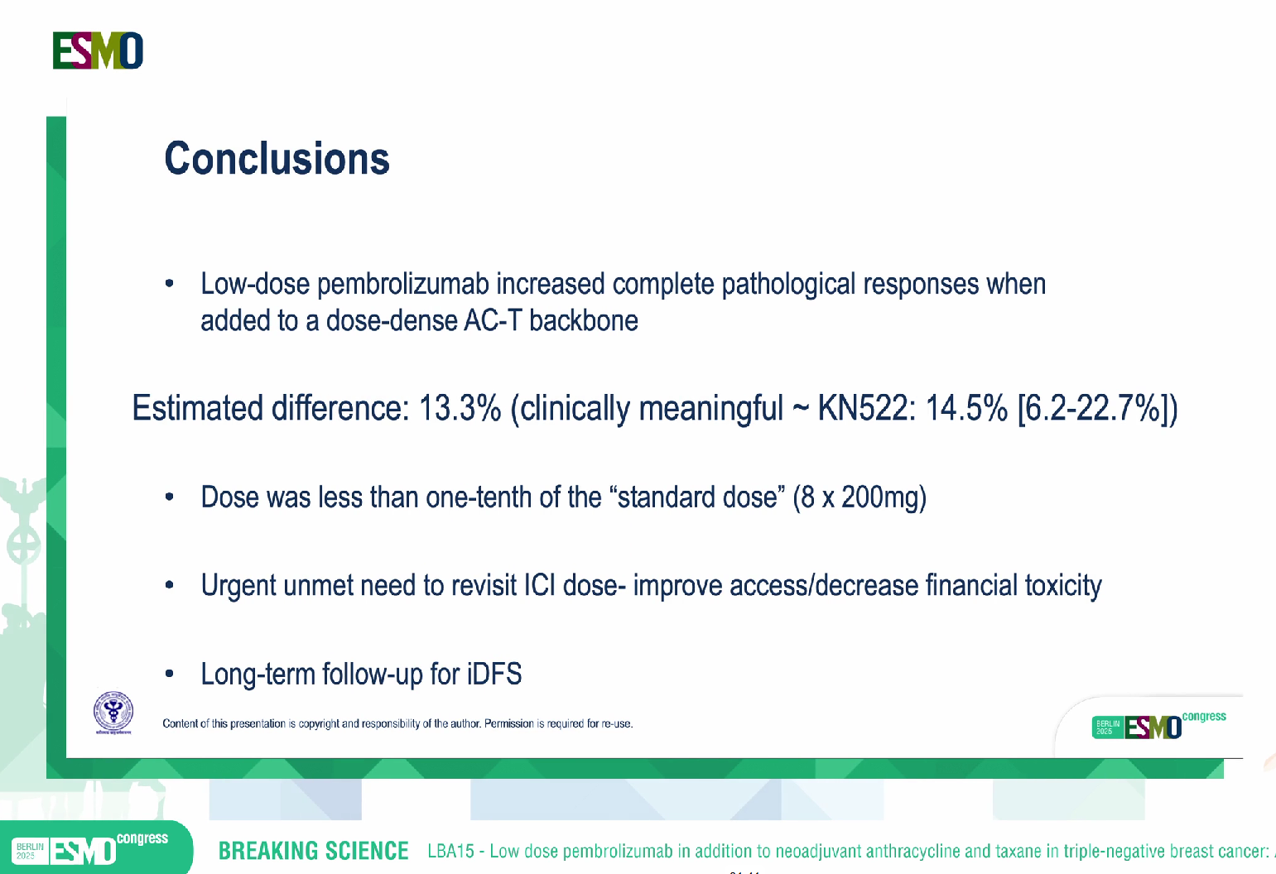
pCR64.8% vs 51.2%; P <.001¹

Slide 11
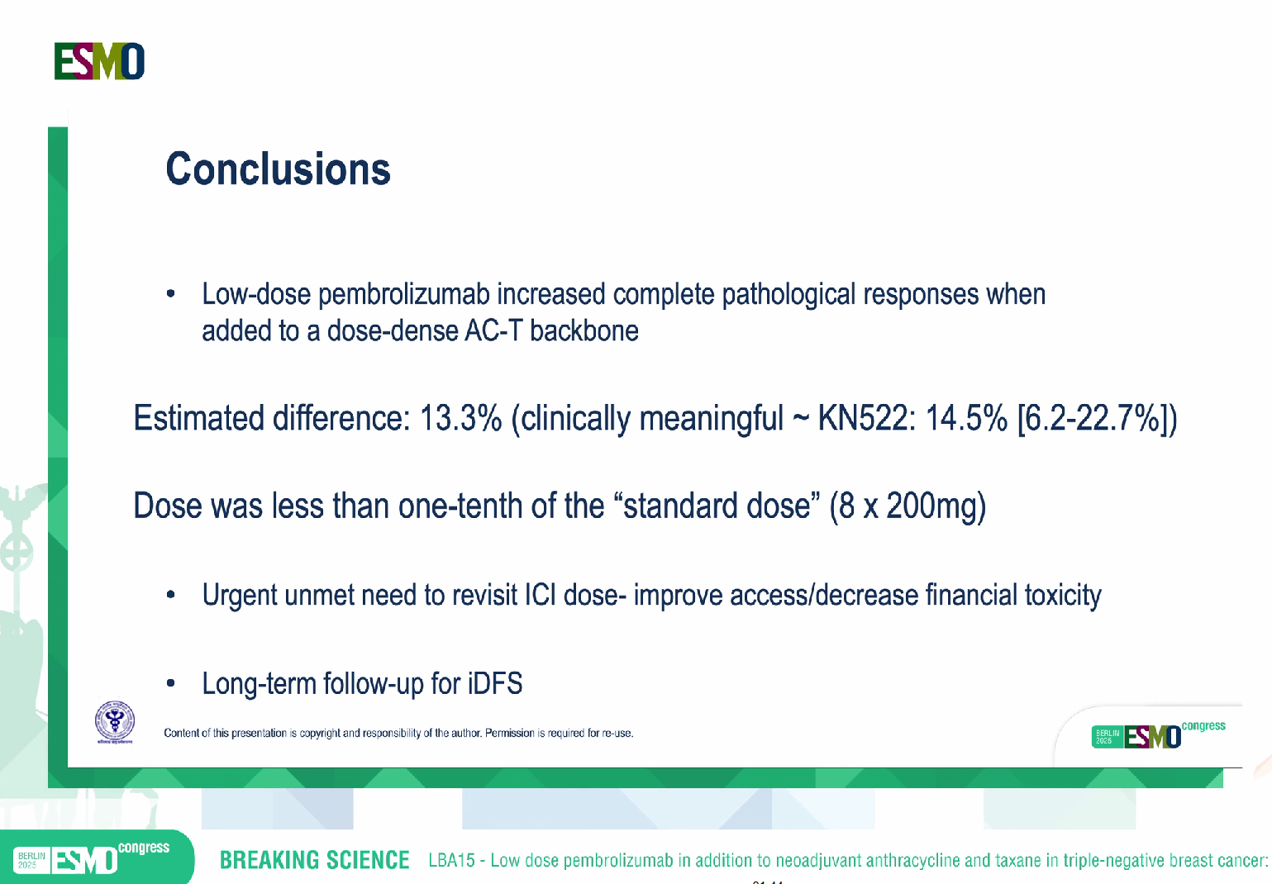
10% SD KEYNOTE-522

Slide 12
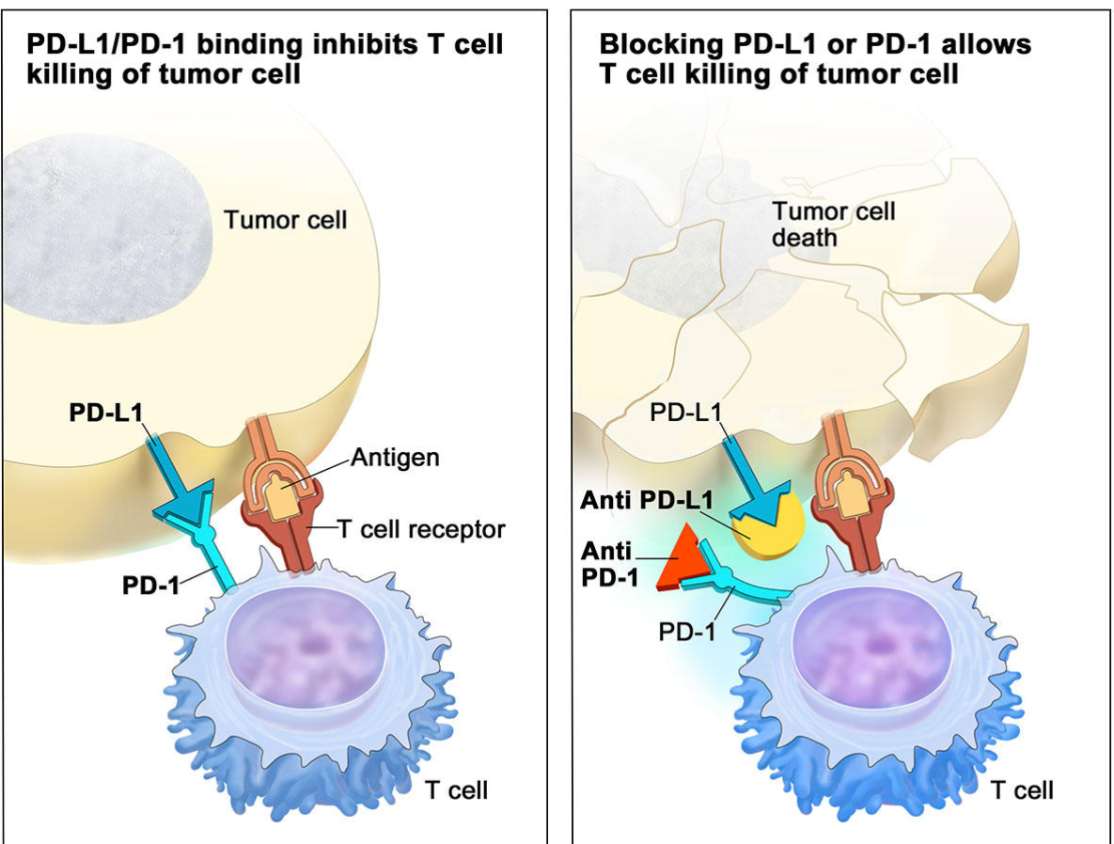
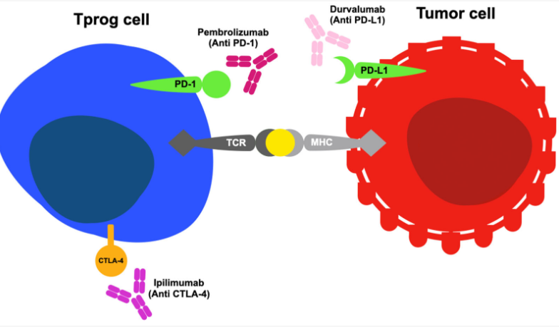

Slide 13
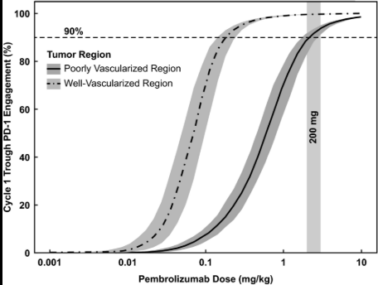
Pharmacokinetics of pembrolizumab
PD-1
50mg Q6W ~
0.4 mg/kg Q3W
50 mg
First published: 19 January 2021 https://doi.org/10.1002/cpt.2170 Citations: 26
DOI: 10.1007/s00330-011-2061-2
DOI: 10.3389/fonc.2022.861151

Slide 14
Pembrolizumab Halfe life
Using the half-life of 23.72 days for pembrolizumab,
Complete washout period will be 237 days.3.
Washout period is generally 10 half-lives.4
3 Canadian Agency for Drugs and Technologies in Health. CADTH technology review: optimal use 360 report: dosing and timing of immuno-oncology drugs. Published online November 2019. Accessed May 19, 2020 at: https://www.cadth.ca/sites/ default/ files/ou-tr/ho0008-dosing-timing- immuno-oncology-drugs.pdf
4 Health Canada. Guidance Document: Conduct and Analysis of Comparative Bioavailability Studies [Internet], 2012. Accessed August 29, 2021 at: https://www.canada.ca/en/health-canada/- services/drugs-health-products/drug-products/applicationssubmissions/guidance-documents/bioavailability-bioequivalence/conduct-analysis-comparative.html

Slide 15
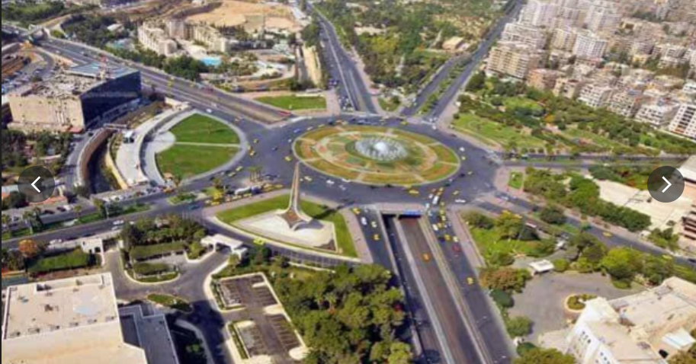
Thank you

Slide 17
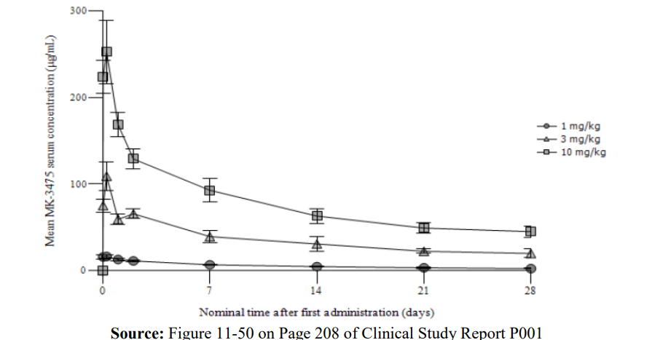

Slide 18
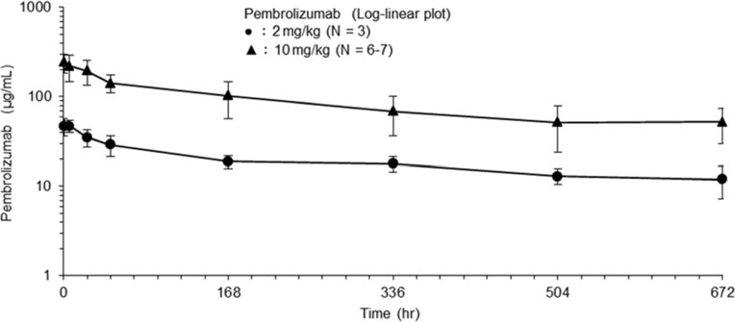

Slide 19
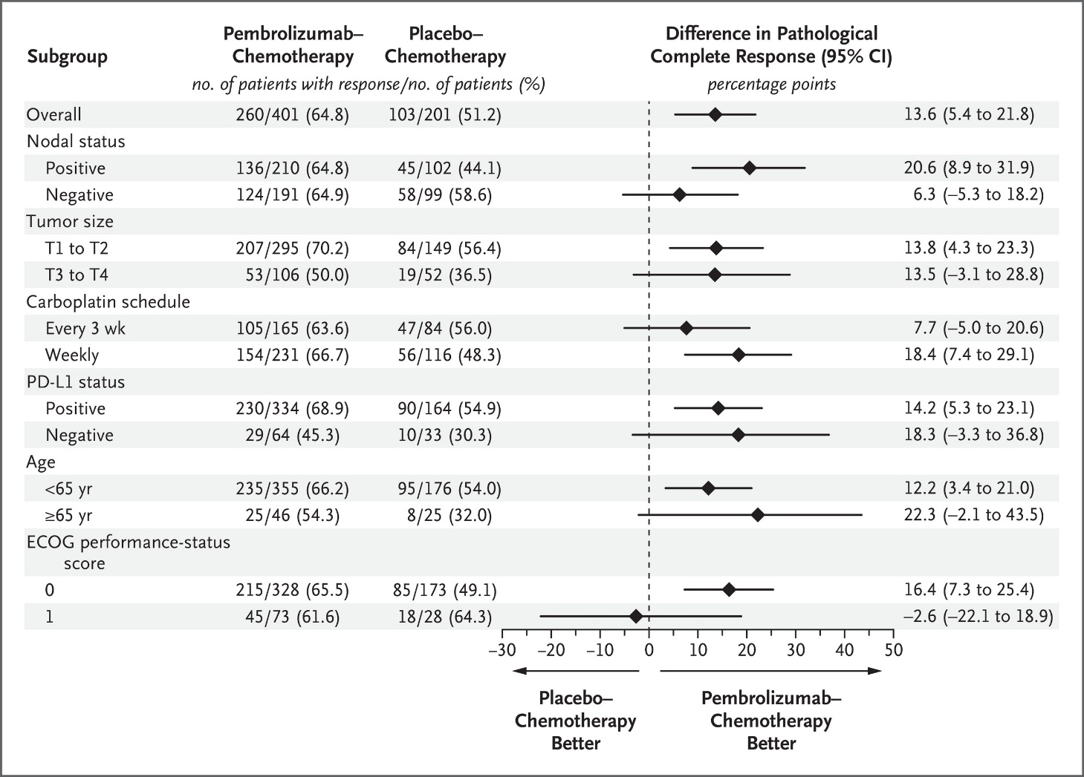
KEYNOTE-522
1 %

Slide 20
KEYNOTE-522 Results:
pCR at interim analysis 1 (IA1; primary endpoint): 64.8% vs 51.2%; P <.001¹
3-yr EFS at IA4 (primary endpoint): 84.5% vs 76.8%; P <.001²
5-yr OS at IA7 (secondary endpoint): 86.6% vs 81.7%; P = .002³
1. Schmid. NEJM. 2020;382:810. 2. Schmid. NEJM. 2022;386:556. 3. Schmid. NEJM. 2024;391:1981. 4. O’Shaughnessy. SABCS 2024. Abstr LB1-07. 5. Dent. SABCS 2024. Abstr PS12-09.
Notes:
CT, chemotherapy; EFS, event-free survival; OS, overall survival; pCR pathologic complete response; TNBC, triple-negative breast cancer; IA, interim analysis

